Slide 1

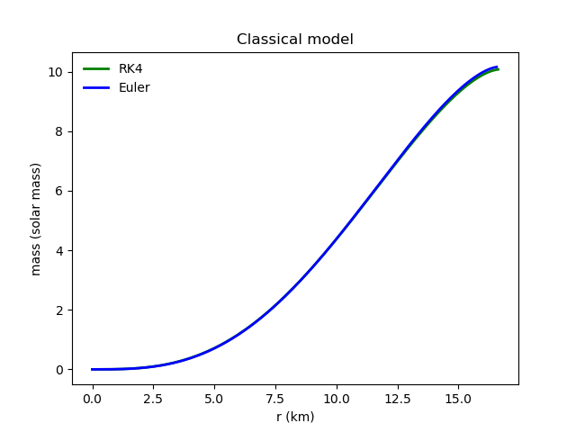
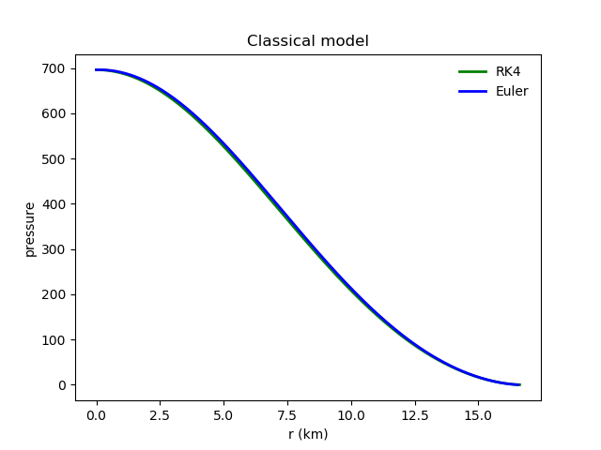
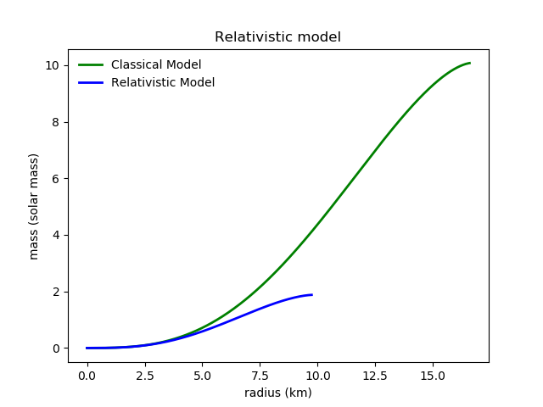
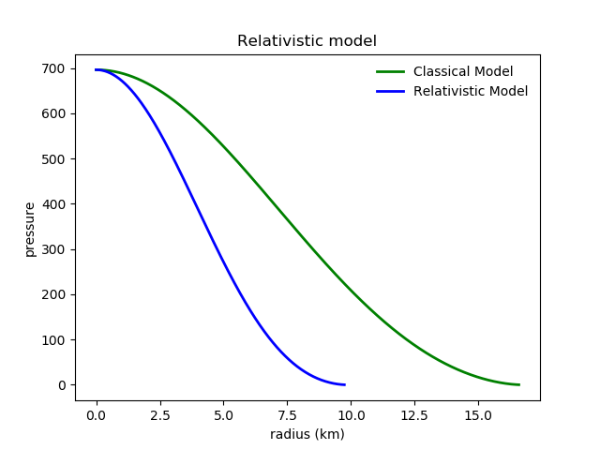
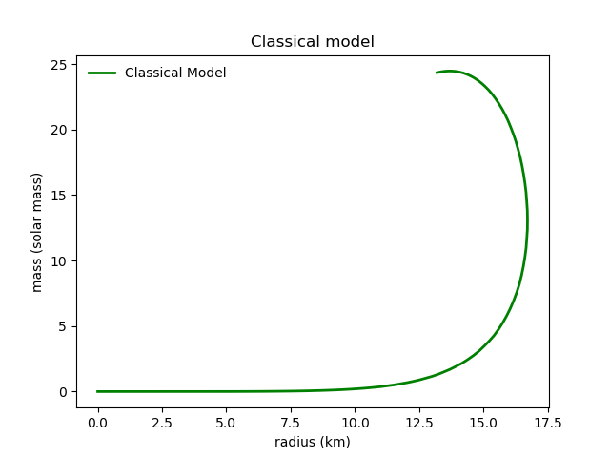
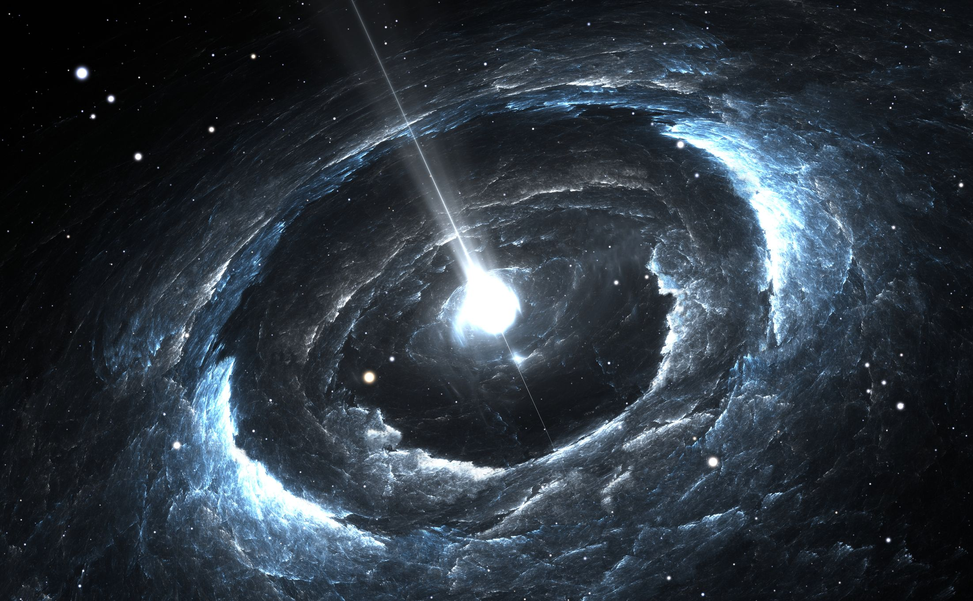
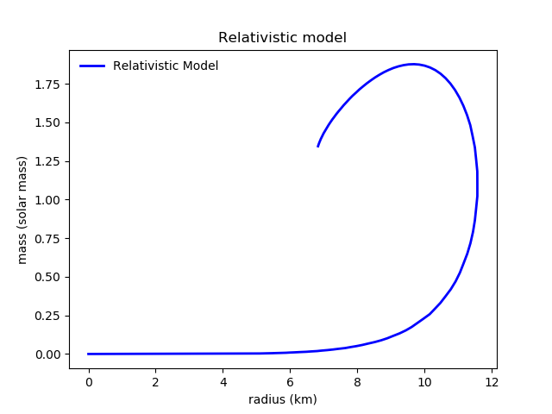
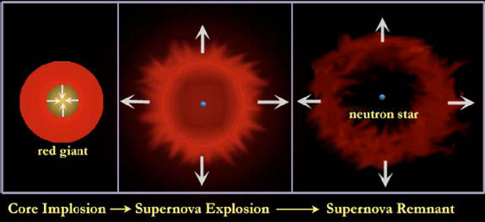
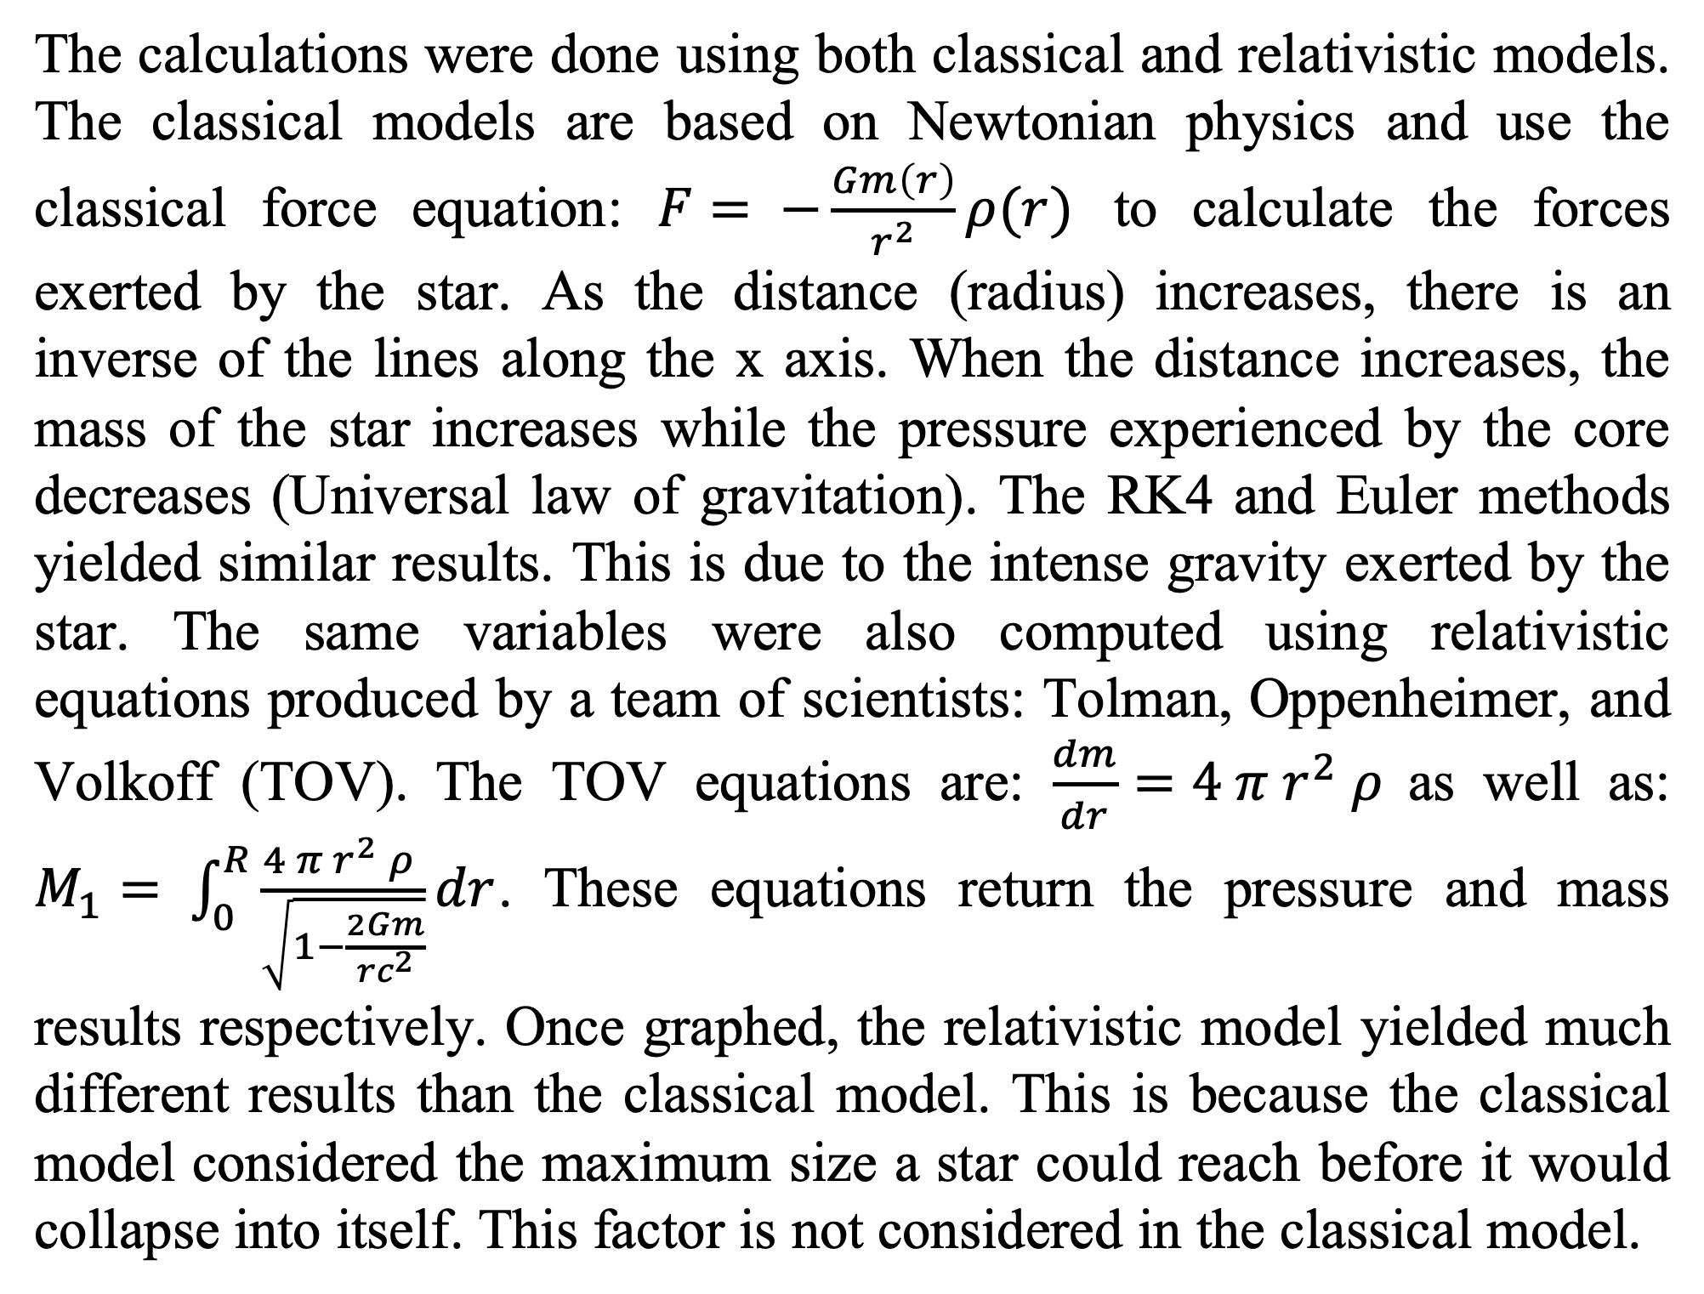
Neutron Star Modeling
Michael Andaloro¹
¹Department of Mathematics, University of Dallas, Irving, TX USA
Abstract
Analysis
Conclusions
As a star enters supernova, the star will explode with the force equal to eight solar masses. When this explosion occurs, there are two possibilities for the resulting star: a black hole or a neutron star. For this star to become a neutron star, specific requirements must be met regarding the mass, density, and radius. This experiment will explore these requirements and will attempt to create a line graph of the constraints of the star.
This project showed the range of values that a neutron star can be created within. Anything outside of this range will result in either the creation of a black hole or nothing will be created from the explosion. We also saw how the classical (Newtonian) model was not an effective solution for measuring these parameters for creating the star. This seems to be a recurring theme whenever large amounts of gravity are present the gravity begins to tamper with the classical model of looking at the universe. The relativistic model was able to compress on a solution much more quickly than the classical model was able to:
Background
Neutron stars only have neutrons left over from a supernova. This star hovers in a state of hydrostatic equilibrium. Although the stars are less than 10km in radius, and weigh only ~1.4 solar masses, they exert a gravitational surface pull of approximately 200,000,000,000 (200 billion) times our own Earth.
Figure 3. Classical vs relativistic models for distance, mass, and pressure graphs. Classical graphs were computed using both RK4 as well as Euler methods. The relativistic model shows a more accurate representation of the limits these stars can reach before they collapse.
The calculations were done using both classical and relativistic models. The classical models are based on Newtonian physics and use the classical force equation: $F= −\frac{Gm\left(r\right)}{r^{2}}ρ(r)$ to calculate the forces exerted by the star. As the distance (radius) increases, there is an inverse of the lines along the x axis. When the distance increases, the mass of the star increases while the pressure experienced by the core decreases (Universal law of gravitation). The RK4 and Euler methods yielded similar results. This is due to the intense gravity exerted by the star. The same variables were also computed using relativistic equations produced by a team of scientists: Tolman, Oppenheimer, and Volkoff (TOV). The TOV equations are: $\frac{dm}{dr}=4 π{ r}^{2} ρ$as well as: $M_{1}= \int_{0}^{R}{\frac{4 π{ r}^{2} ρ }{\sqrt{1−\frac{2Gm}{rc^{2}}}}dr}$. These equations return the pressure and mass results respectively. Once graphed, the relativistic model yielded much different results than the classical model. This is because the classical model considered the maximum size a star could reach before it would collapse into itself. This factor is not considered in the classical model.
Figure 4. Each of the models was calculated using their respective functions. To determine which function was more efficient. The runtime of the relativistic model was able to find the solution in almost half the RK4 iterations. A solution is considered found when the pressure becomes negative (outside the star).
Figure 1. A neutron star surrounded by the remnants of a supernova.
Observations
A red giant is a star that is held in hydrostatic equilibrium by the pressure produced by the fusion reactions occurring at the core. When there is a lack of hydrogen atoms to keep these reactions active, the core begins to collapse. When the core collapses, the immense pressure causes the remaining atoms to explode. This explosion is so strong that it fuses electrons and protons from the hydrogen and helium atoms within the star together to form neutrons. If there is enough neutrons, they will pull each other together and form a neutron star, if there are too many neutrons, however, then the intense gravity will cause them to collapse into a black hole. The creation of a neutron star requires specific parameters to be met and these parameters will be further explored in this project.
Discussion
References
We use these equations to generate several graphs that depict what happens to the neutron star as the radius is changed. The mass and pressure both change and when these values become impossible (e.g. the pressure becomes negative), it means the star no longer exists and the calculations are re-done with a slightly different radius.
Faizi, Sarah, and Craig Fischer. “Pauli Exclusion Principle.” Libretexts.org, 5 June 2019, https://chem.libretexts.org/Bookshelves/Physical_and_Theoretical_Chemistry_Textbook_Maps/Supplemental_Modules_(Physical_and_Theoretical_Chemistry)/Electronic_Structure_of_Atoms_and_Molecules/Electronic_Configurations/Pauli_Exclusion_Principle.
Myers, Steven T. “Lecture 18 - White Dwarfs & Neutron Stars (3/23/99).” Nrao.edu, 23 Mar. 1999, http://www.aoc.nrao.edu/~smyers/courses/astro12/L18.html.
Nozawa, T, et al. “Construction of Highly Accurate Models of Rotating Neutron Stars - Comparison of Three Different Numerical Schemes.” Aanda.org, 6 May 1998, https://aas.aanda.org/articles/aas/full/1998/18/ds7680/node4.html.
Burns, D, and R Dawson. “MODELLING OF NEUTRON STARS.” University of Manchester School of Physics and Astronomy, Apr. 2010, pp. 1–10., http://www.hep.man.ac.uk/u/russell/Neutron_Star_Report.pdf.
Figure 2. A diagram of how a neutron star is formed from the remnants of a supernova. The star is created from neutrons that result from protons and electrons being split from the hydrogen and helium atoms in the former star.

